Slide 1
API & REST

Slide 2
WHAT ARE APIs?

Slide 3
API is the acronym for
Application Programming Interface

Slide 4
APIs
APIs are a set of functions and procedures that allow applications to access features or data of an operating system, another application and/or a service .
In simplicity it allows the interaction between two different applications using a set of rules.
APIs are beneficial because they allow developers to add specific functionality to an application, without having to write all of the code themselves. APIs also allow developers to access data from other applications. For example, when bloggers put their Twitter handle on their blog’s sidebar

Slide 5
Uses of APIs
API can be used to get access to data from a third party
Extend the functionality of an app
Hide Complexity of functionality from another developer
APIs are everywhere!!!!!!!
There are APIs in your browser, smart phone, operating system and the list goes on.

Slide 6




Uses of APIs

Slide 7
REST API

Slide 8
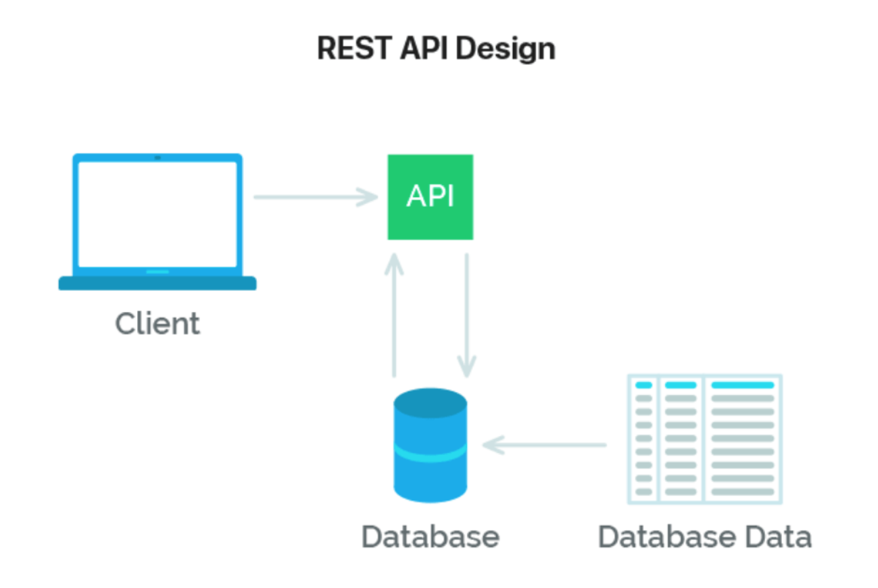

Slide 9
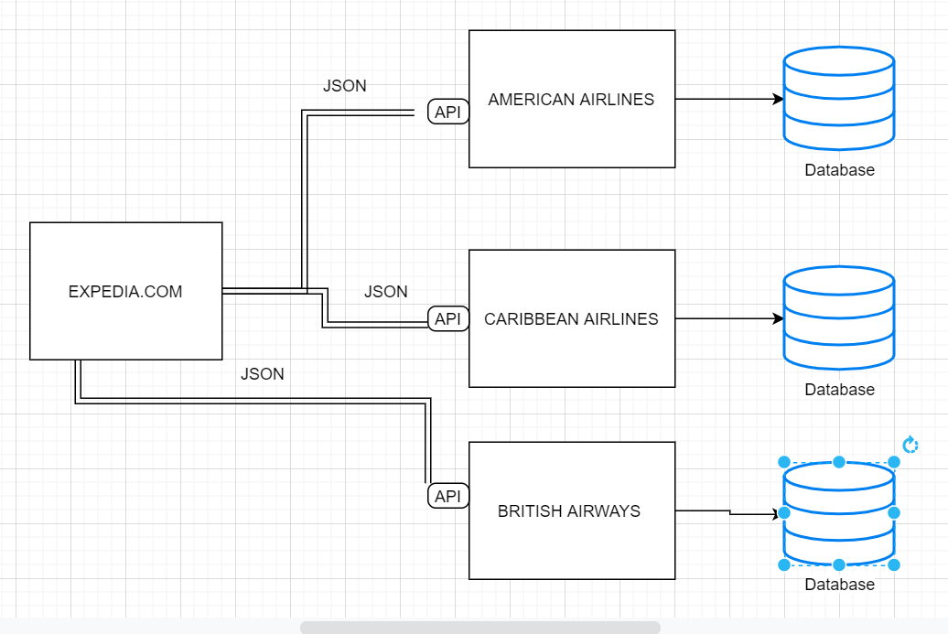
Expedia.com (API Example)

Slide 10
REST APIs
REST stands for REpresentational State Transfer. It is a set of rules that developers follow when they create their API.
One of these rules states that you should be able to get a piece of data (called a resource) when you link to a specific URL.
Each URL is called a request while the data sent back to you is called a response.

Slide 11
Anatomy of a Request
It’s important to know that a request is made up of four things:
The endpoint - The URL to access the API resource
The method - The type of HTTP Request you sending to the API
The headers - Information that is available to both client and server
The data (or body)-

Slide 12
JSON
JavaScript Object Notation

Slide 13
JavaScript Object Notation (JSON)
JSON stands for JavaScript Object Notation.
Is a lightweight data-interchange format. It is easy for humans to read and write. It is easy for machines to parse and generate.
Besides that, you can store text (string), numeric (integers and floats) and boolean data as well as nested objects and arrays.

Slide 14
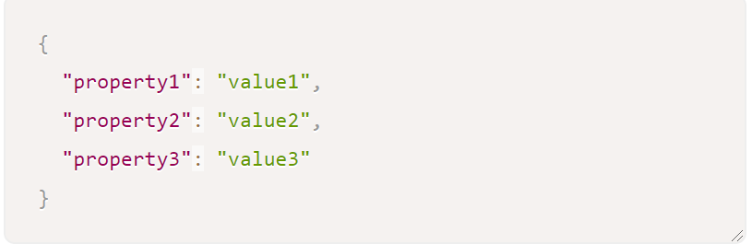
JSON Cont’d
JSON is a common format for sending and requesting data through a REST API.
A JSON object looks like a JavaScript Object. In JSON, each property and value must be wrapped with double quotation marks, like this:

Slide 15
HOW TO CONSUME A REST API IN JAVASCRIPT?

Slide 16
API Consumption in JavaScript
The common ways of consuming REST APIs in JavaScript are as follows :
Using the XHR Object- This is the oldest way of consuming in JavaScript
Fetch API - This is the modern way of consuming REST APIs in JavaScript
Axios - This is a 3rd party library that allows you to consume REST APIs in JavaScript

Slide 17
THE END

